Slide 1

What Matters in SPA?
Hasith Yaggahavita

Slide 2
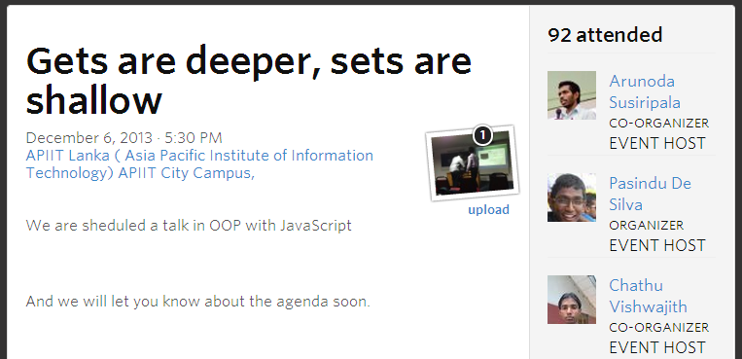

Slide 3
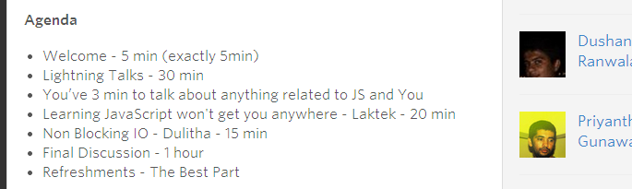

Slide 4
if you expect JavaScript doing any ‘real work’ Treat it as a ‘real language’
- Brandon Keepers

Slide 5
Let’s just recap a bit of JavaScript Concepts!
Notes:
Knowledge of audience

Slide 6
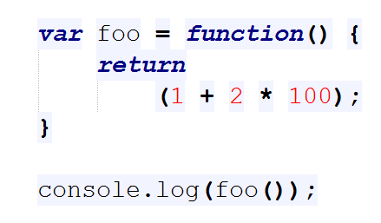
1
A) 201
B) 300
C) ReferenceError
D) undefined

Slide 7
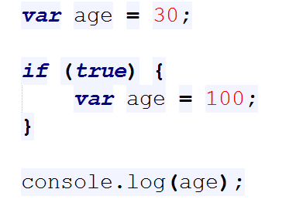
2
A) Error
B) 100
C) 30
D) Non of above

Slide 8
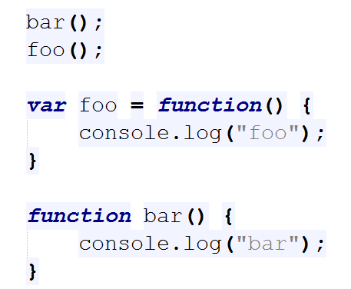
3
A) bar
foo
B) ReferenceError
C) bar
TypeError
D) Non of above

Slide 9
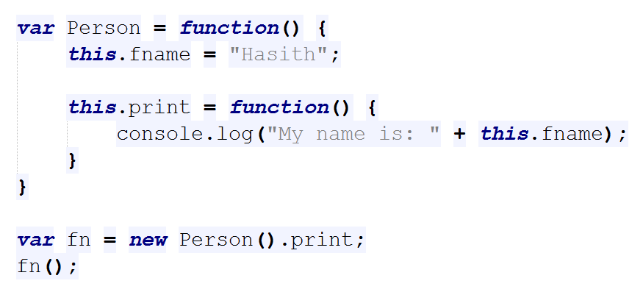
$
A) My name is: Hasith
B) Error
C) My name is: null
D) Non of above

Slide 10
What should you absolutely know?
Behavior of variables (e.g. global, scoped)
Semicolon injection
Function scopes
Variable/function hoisting
Parameter passing
Operator behavior (e.g. === vs ==)
null, undefined, false, NaN, ReferenceError
Lamda nature
Closures and static scoping
Module Pattern
Prototypical Inheritance

Slide 11
A bit of a history with…
Netscape
Sun
Microsoft
W3C
ECMA
Notes:
Mocha, LiveScript

Slide 12
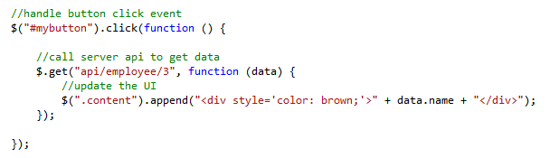
How about the ‘jQuery’ way?

Slide 13
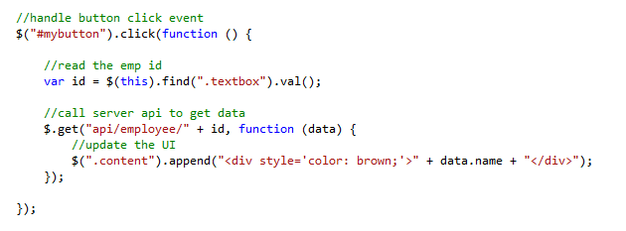
How about the ‘jQuery’ way?

Slide 14
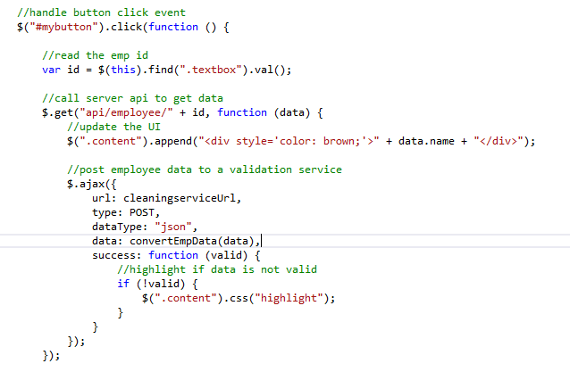

Slide 15
User event
Read input
Server callback
Display data
Server call
Nested server call
Data conversion
Nested callback
UI update

Slide 16

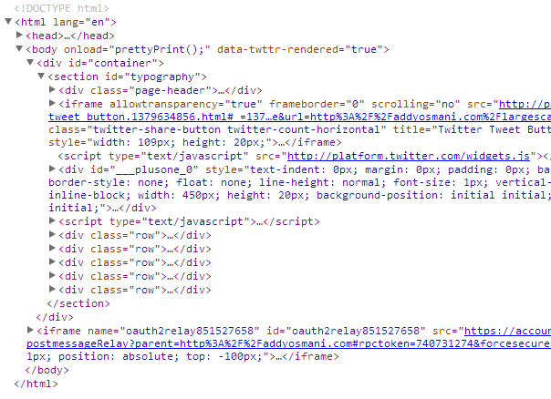
The DOM – an ugly ball of state

Slide 17
We need a better way !!!

Slide 18
Let’s learn some SPA principles!

Slide 19
Principle #1 : Move state out of DOM

Slide 20
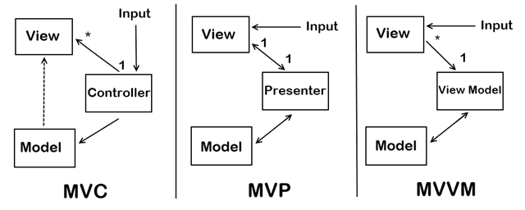
Principle #1 : Move state out of DOM
Backbone
Batman
Spine
Sproutcore
ASP.NET Webforms
GWT
Knockout
Angular

Slide 21
Principle #1 : Move state out of DOM
Principle #2 : Know your responsibilities

Slide 22
Principle #2 : Know your responsibilities
behavior
presentation
Structure

Slide 23
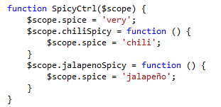
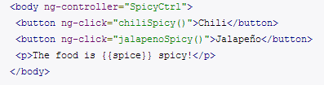
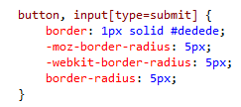
Principle #2 : Know your responsibilities
logic.js
view.html
style.css

Slide 24
Principle #1 : Move state out of DOM
Principle #2 : Know your responsibilities
Principle #3 : Be self contained

Slide 25
The secret to build large apps is never build large apps.
-Justin Meyer

Slide 26

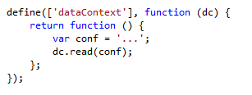
Principle #3: Be self contained
File dependencies
CommonJS
ECMAScript 6
AMD

Slide 27
Principle #3: Be self contained
Testability?

Slide 28
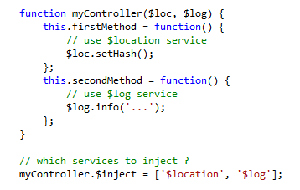
Principle #3: Be self contained
Object dependencies:
Pass in dependent objects

Slide 29
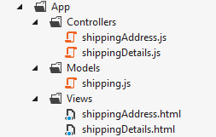
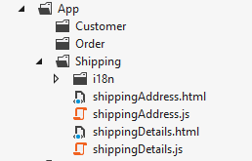
Principle #3: Be self contained
Be modular:
Package by layer
Package by feature

Slide 30
Principle #1 : Move state out of DOM
Principle #2 : Know your responsibilities
Principle #3 : Be self contained
Principle #4 : Use real power of ‘Web’

Slide 31
Principle #4: Use real power of ‘Web’
Many treat URL as an afterthought, instead of the primary reason for the web's success.
http://emberjs.com

Slide 32
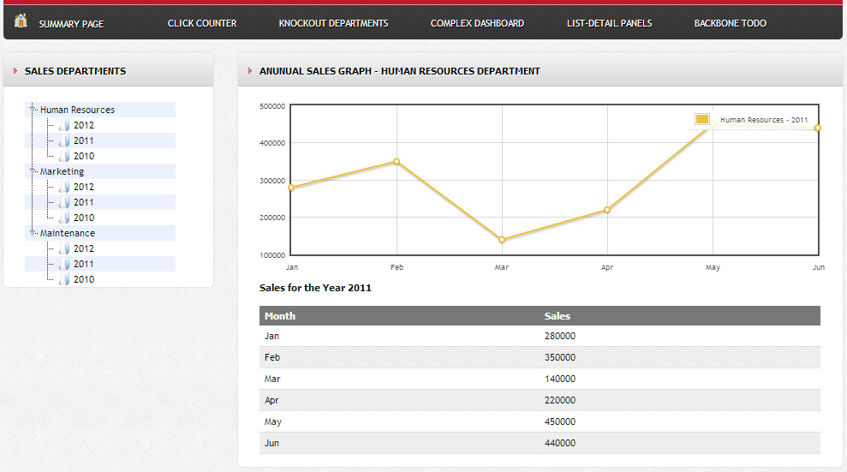
Principle #4: Use real power of ‘Web’
http://boilerplatejs.org/samples/productsuite#sales

Slide 33
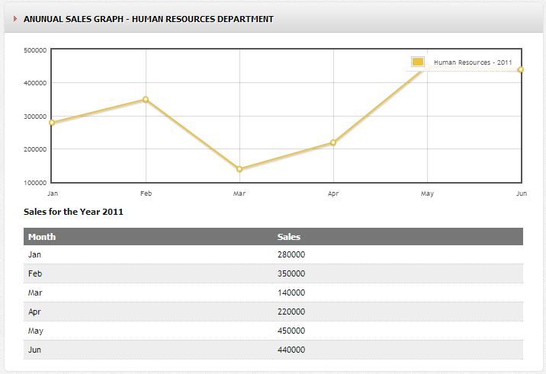
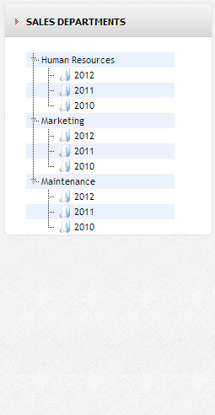
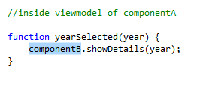
Principle #4: Use real power of ‘Web’
Component B
Component A
http://boilerplatejs.org/samples/productsuite#sales

Slide 34
Principle #4: Use real power of ‘Web’
Component B
cv
Listen(callback)
Raise(data)
Event Mediator
Callback(data)
Component A
http://boilerplatejs.org/samples/productsuite#sales

Slide 35
Principle #4: Use real power of ‘Web’
Component B
cv
Change Route
Listen to Route
Component A
http://boilerplatejs.org/samples/productsuite#sales
/hr/2012

Slide 36
Principle #1 : Move state out of DOM
Principle #2 : Know your responsibilities
Principle #3 : Be self contained
Principle #4 : Know the power of ‘Web’

Slide 37
Avoid vendor locking
Rich set of UI widgets (KendoUI)
MV* for User Interface Components (KnockoutJS)
Framework for Styling and Responsive Design (Bootstrap)
. . .
Code Quality and Validation (JSLint)
. . .
Optimizations/Uglyfication (RequireJS)
Server communication (BreezeJS)
Routing, Navigation and Page Activation (DurandalJS)
JavaScript dependency management (RequireJS)

Slide 38
It doesn’t end there…
JavaScript async programming style (callbacks, promises)
What’s the toolset I need to use (IDE, jsLint, debugger, REST tools…)?
How do I unit test my JavaScript code (CI, unit, integration)?
How can I implement cross cutting aspects like theming, i18n?
What about security of my JS frontend?
How can I do optimizations for better performance?
Use of an abstraction language (coffeescript, typescript, less)?
….

Slide 39
Questions?

